Slide 1
ADVANCED SERVLET and SESSION TRACKING
Instructor:

Slide 2
Learning Goals
Understand Servlet
Can use Servlet to develop web application

Slide 3
Table Content
Servlet Exception Hadling
ServletConfig and servletcontext
Servlet Session Tracking
Q&A

Slide 4
Servlet exception hadling
Section 1

Slide 5
Servlet Exception Handling
We can define custom error handling using a web.xml file descriptor in which we can define the following types of policies:
Status code error handling – it allows us to map HTTP error codes (client and server) to a static HTML error page or an error handling servlet
Exception type error handling – it allows us to map exception types to static HTML error pages or an error handling servlet
Status Code Error Handling with an HTML Page
Example1:
<web-app xmlns:xsi=http://www.w3.org/2001/XMLSchema-instance xmlns="http://java.sun.com/xml/ns/javaee"
xsi:schemaLocation="http://java.sun.com/xml/ns/javaee http://java.sun.com/xml/ns/javaee/web-app_3_1.xsd"
version="3.1">
<error-page>
<error-code>404</error-code>
<location>/error-404.html</location> <!-- /src/main/webapp/error-404.html-->
</error-page>
</web-app>

Slide 6
Servlet Exception Handling
Exception Type Error Handling with a Servlet
Example 2:
<web-app xmlns:xsi="http://www.w3.org/2001/XMLSchema-instance" xmlns="http://java.sun.com/xml/ns/javaee"
xsi:schemaLocation="http://java.sun.com/xml/ns/javaee http://java.sun.com/xml/ns/javaee/web-app_3_1.xsd"
version="3.1">
<error-page>
<exception-type>java.lang.Exception</exception-type>
<location>/errorHandler</location>
</error-page>
</web-app>
Notes:
// Analyze the servlet exception
Throwable throwable = (Throwable) request
.getAttribute("javax.servlet.error.exception");
Integer statusCode = (Integer) request
.getAttribute("javax.servlet.error.status_code");
String servletName = (String) request
.getAttribute("javax.servlet.error.servlet_name");
if (servletName == null) {
servletName = "Unknown";
}
String requestUri = (String) request
.getAttribute("javax.servlet.error.request_uri");
if (requestUri == null) {
requestUri = "Unknown";
}

Slide 7
Servlet Exception Handling
Create class ErrorHandlerServlet, we can access the error details using the error attributes provided in the request:
@WebServlet(urlPatterns = "/errorHandler")
public class ErrorHandlerServlet extends HttpServlet {
@Override
protected void doGet( HttpServletRequest req, HttpServletResponse resp) throws IOException {
resp.setContentType("text/html; charset=utf-8");
try (PrintWriter writer = resp.getWriter()) {
writer.write("<html><head><title>Error description</title></head><body>");
writer.write("<h2>Error description</h2>");
writer.write("<ul>");
Arrays.asList(ERROR_STATUS_CODE, ERROR_EXCEPTION_TYPE, ERROR_MESSAGE)
.forEach(e -> writer.write("<li>" + e + ":" + req.getAttribute(e) + " </li>")
);
writer.write("</ul>");
writer.write("</html></body>");
}
}
}
Notes:
// Analyze the servlet exception
Throwable throwable = (Throwable) request
.getAttribute("javax.servlet.error.exception");
Integer statusCode = (Integer) request
.getAttribute("javax.servlet.error.status_code");
String servletName = (String) request
.getAttribute("javax.servlet.error.servlet_name");
if (servletName == null) {
servletName = "Unknown";
}
String requestUri = (String) request
.getAttribute("javax.servlet.error.request_uri");
if (requestUri == null) {
requestUri = "Unknown";
}

Slide 8
ServletConfig and servletcontext
Section 2

Slide 9
Introduction
An object of ServletConfig is created by the web container for each servlet. This object can be used to get configuration information from web.xml file.
If the configuration information is modified from the web.xml file, we don't need to change the servlet. So it is easier to manage the web application if any specific content is modified from time to time.
Methods of ServletConfig interface:
public String getInitParameter(String name):Returns the parameter value for the specified parameter name.
public Enumeration getInitParameterNames():Returns an enumeration of all the initialization parameter names.
public String getServletName():Returns the name of the servlet.
public ServletContext getServletContext():Returns an object of ServletContext.

Slide 10
ServletConfig
web.xml file: The init-param sub-element of servlet is used to specify the initialization parameter for a servlet.
<?xml version="1.0" encoding="UTF-8"?>
<web-app xmlns:xsi="http://www.w3.org/2001/XMLSchema-instance"
xmlns=http://java.sun.com/xml/ns/javaee xmlns:jsp=http://java.sun.com/xml/ns/javaee/jsp
xsi:schemaLocation=http://java.sun.com/xml/ns/javaee http://java.sun.com/xml/ns/javaee/web-app_3_0.xsd version="3.0">
<servlet>
<servlet-name>welcome</servlet-name>
<servlet-class>com.fsoft.controller.WelcomeServlet</servlet-class>
<init-param>
<param-name>driver</param-name>
<param-value>com.microsoft.sqlserver.jdbc.SQLServerDriver</param-value>
</init-param>
</servlet>
<welcome-file-list>
<welcome-file>/views/sign-in.jsp</welcome-file>
</welcome-file-list>
</web-app>

Slide 11
ServletConfig
How to get the object of ServletConfig:
Use getServletConfig() method of Servlet interface returns the object of ServletConfig.
Via init() method of a Servlet:
@WebServlet("/AppServlet")
public class AppServlet extends HttpServlet {
private static final long serialVersionUID = 1L;
@Override
public void init(ServletConfig config) throws ServletException {
String driver = config.getInitParameter("driver");
Log4J.getLogger().info(driver); }
}

Slide 12
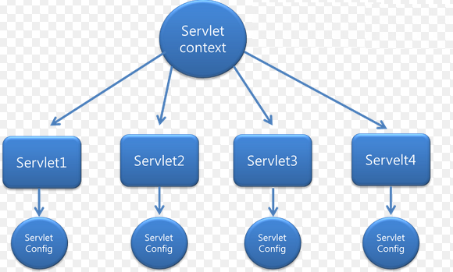
ServletContext
An object of ServletContext is created by the web container at time of deploying the project. This object can be used to get configuration information from web.xml file.
Servlet Context has 3 main methods:
GetAttribute ()
SetAttribute ()
RemoveAttribute ()
Servlet Context help provides communication between the servlet
There is only one ServletContext object per web application.
Notes:
There is only one ServletContext object per web application.
If any information is shared to many servlet, it is better to provide it from the web.xml file using the <context-param> element.
Easy to maintain if any information is shared to all the servlet, it is better to make it available for all the servlet. We provide this information from the web.xml file, so if the information is changed, we don't need to modify the servlet. Thus it removes maintenance problem.

Slide 13
ServletContext
Advantage of ServletContext:
Easy to maintain if any information is shared to all the servlet, it is better to make it available for all the servlet.
We provide this information from the web.xml file, so if the information is changed, we don't need to modify the servlet.
Thus it removes maintenance problem.
Notes:
There is only one ServletContext object per web application.
If any information is shared to many servlet, it is better to provide it from the web.xml file using the <context-param> element.
Easy to maintain if any information is shared to all the servlet, it is better to make it available for all the servlet. We provide this information from the web.xml file, so if the information is changed, we don't need to modify the servlet. Thus it removes maintenance problem.

Slide 14
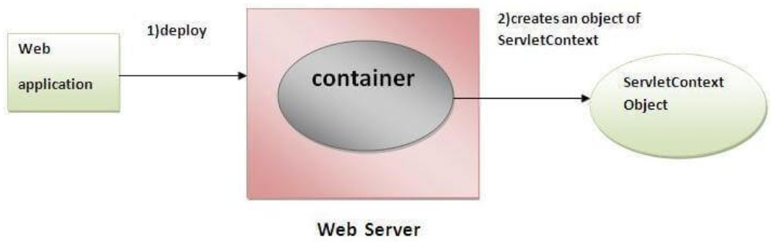
ServletContext
Usage of ServletContext Interface:
The object of ServletContext provides an interface between the container and servlet.
The ServletContext object can be used to get configuration information from the web.xml file.
The ServletContext object can be used to set, get or remove attribute from the web.xml file.
The ServletContext object can be used to provide inter-application communication.
https://www.javatpoint.com

Slide 15
ServletContext
Methods of ServletContext interface:
public String getInitParameter(String name):
Returns the parameter value for the specified parameter name.
public Enumeration getInitParameterNames():
Returns the names of the context's initialization parameters.
public void setAttribute(String name,Object object):
sets the given object in the application scope.
public Object getAttribute(String name):
Returns the attribute for the specified name.
public Enumeration getInitParameterNames():
Returns the names of the context's initialization parameters as an Enumeration of String objects.
public void removeAttribute(String name):
Removes the attribute with the given name from the servlet context.
https://www.javatpoint.com

Slide 16
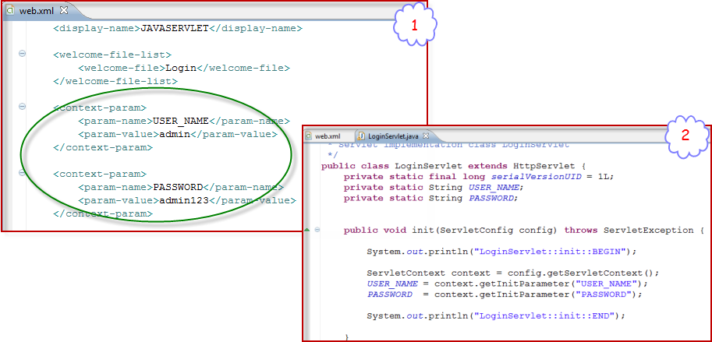
ServletContext Example

Slide 17
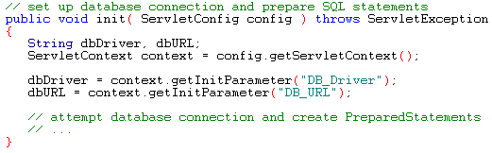
Servlet Context Sample
We can change the init() method of the as below:
Then we need to amend the web.xml file to specify the initial context parameters:

Slide 18
Session Tracking
Section 3

Slide 19
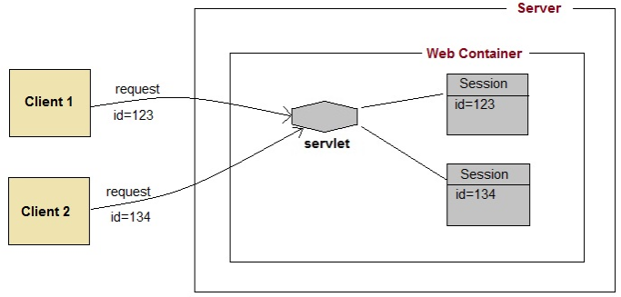
Introduction
HTTP protocol and Web Servers are stateless, what it means is that for web server every request is a new request to process.
But sometimes in web applications, we should know who the client is and process the request accordingly^{[phù hợp]}.
Session Management is a mechanism used by the Web container to store session information for a particular user:
Cookies
Hidden form field
URL Rewriting
HttpSession

Slide 20
Session Tracking Cookie in Servlet
A cookie is a small piece of information that is persisted between the multiple client requests.
A cookie has a name, a single value, and optional attributes such as a comment, path and domain qualifiers, a maximum age, and a version number.
How Cookie works:
By default, each request is considered as a new request.
In cookies technique, we add cookie with response from the servlet.
So cookie is stored in the cache of the browser. After that if request is sent by the user, cookie is added with request by default. Thus, we recognize the user as the old user.
Types of Cookie:
Non-persistent cookie: It is valid for single session only. It is removed each time when user closes the browser
Persistent cookie: It is valid for multiple session . It is not removed each time when user closes the browser. It is removed only if user logout or signout.

Slide 21
Session Tracking Cookie in Servlet
Advantages
Remember user IDs and password.
To track visitors on a Web site for better service and new features.
Cookies enable efficient ad processing.
Disadvantages
The size and number of cookies stored are limited.
Personal information is exposed to the other users.
Cookies fails to work if the security level is set too high in the Internet browser.
Servlet CookieServlet
Handles both get and post requests

Slide 22
Session Tracking Cookie in Servlet
Cookie class: javax.servlet.http.Cookie class provides the functionality of using cookies. It provides a lot of useful methods for cookies.
Constructors:
Methods:
Constructor | Description
Cookie() | constructs a cookie.
Cookie(String name, String value) | constructs a cookie with a specified name and value.
Method | Description
public void setMaxAge(int expiry) | Sets the maximum age of the cookie in seconds.
public String getName() | Returns the name of the cookie. The name cannot be changed after creation.
public String getValue() | Returns the value of the cookie.
public void setName(String name) | changes the name of the cookie.
public void setValue(String value) | changes the value of the cookie.

Slide 23
Session Tracking Cookie in Servlet
Other methods required for using Cookies:
public void addCookie(Cookie ck):method of HttpServletResponse interface is used to add cookie in response object.
public Cookie[] getCookies():method of HttpServletRequest interface is used to return all the cookies from the browser.
How to create Cookie?
How to delete Cookie?
How to get Cookies?
Cookie ck=new Cookie("user","sonoo jaiswal");//creating cookie object
response.addCookie(ck);//adding cookie in the response
Cookie ck=new Cookie("user","");//deleting value of cookie
ck.setMaxAge(0);//changing the maximum age to 0 seconds
response.addCookie(ck);//adding cookie in the response
Cookie ck[]=request.getCookies();
for(int i=0;i<ck.length;i++){
out.print("<br>"+ck[i].getName()+" "+ck[i].getValue());
//printing name and value of cookie
}

Slide 24
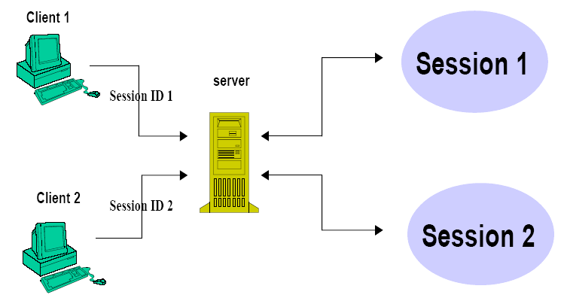
Session Tracking HttpSession
The servlet API has a built-in support for session tracking.
Session objects live on the server.
Each user has associated an HttpSession object—one user/session
HttpSession object operates like a hashtable

Slide 25
Session Tracking HttpSession
The container creates a session id for each user. Container uses this id to identify the particular user. An object of HttpSession can be used to perform two tasks:
bind objects
view and manipulate information about a session, such as the session identifier, creation time, and last accessed time.
How to get the HttpSession object?
public HttpSession getSession(): Returns the current session associated with this request, or if the request does not have a session, creates one.
public HttpSession getSession(boolean create): Returns the current HttpSession associated with this request or, if there is no current session and create is true, returns a new session.

Slide 26
Session Tracking HttpSession
Methods of HttpSession
public String getId():Returns a string containing the unique identifier value.
public void setAttribute(String name, Object value): Binds the object with a name and stores the name/value pair as an attribute of the HttpSession object. If an attribute already exists, then this method replaces the existing attributes.
public Object getAttribute(String name): Returns the String object specified in the parameter, from the session object. If no object is found for the specified attribute, then the getAttribute() method returns null.
public Enumeration getAttributeNames(): Returns an Enumeration that contains the name of all the objects that are bound as attributes to the session object.
public void removeAttribute(String name): Removes the given attribute from session.
setMaxInactiveInterval(int interval): Sets the session inactivity time in seconds. This is the time in seconds that specifies how long a sessions remains active since last request received from client.
public void invalidate():Invalidates this session then unbinds any objects bound to it.

Slide 27
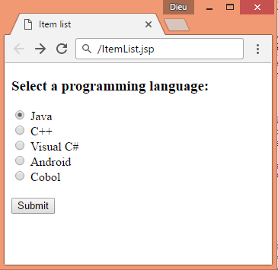
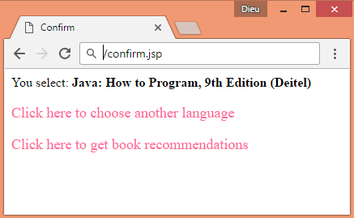
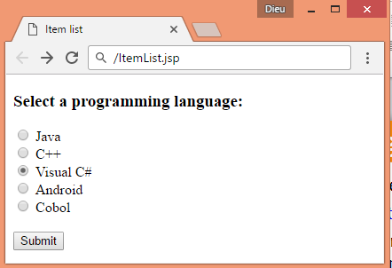
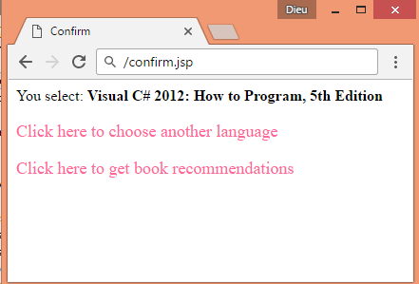
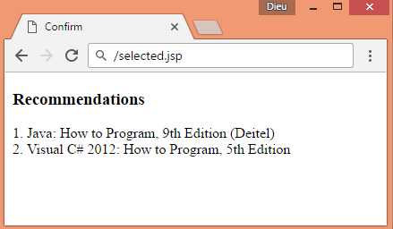
Session Tracking HttpSession

Slide 28
Session Tracking HttpSession
Example:
login.html
FirstServlet.java
<form action="FirstServlet">
User Name:<input type="text" name="userName"/><br/>
Password:<input type="password" name="userPassword"/><br/>
<input type="submit" value="Submit"/>
</form>
@WebServlet("/FirstServlet")
public class FirstServlet extends HttpServlet {
public void doGet(HttpServletRequest request, HttpServletResponse response){
try{
response.setContentType("text/html");
PrintWriter out = response.getWriter();
String userName =request.getParameter("userName");
out.print("Welcome "+ userName);
HttpSession session=request.getSession();
session.setAttribute("uname", userName);
out.print("<br><a href= 'SecondServlet'>Visit</a>");
out.close();
}catch(Exception e){System.out.println(e);}
}
}

Slide 29
Session Tracking HttpSession
Example:
SecondServlet.java
@WebServlet("/SecondServlet")
public class SecondServlet extends HttpServlet {
public void doGet(HttpServletRequest request,
HttpServletResponse response)
try{
response.setContentType("text/html");
PrintWriter out = response.getWriter();
HttpSession session=request.getSession(false);
String userName =(String)session.getAttribute("uname");
out.print("Hello " + userName);
out.close();
}catch(Exception e){System.out.println(e);}
}
}

Slide 30
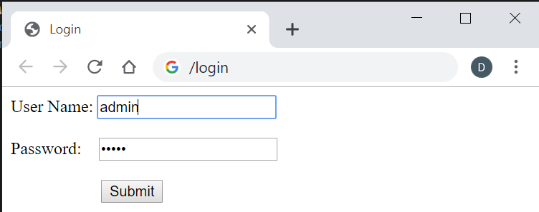
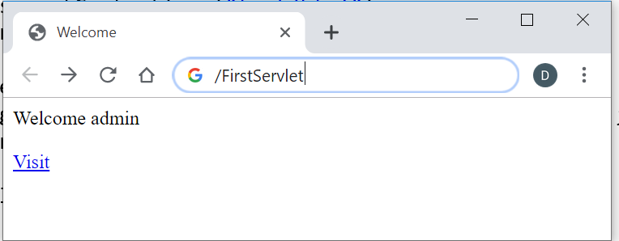
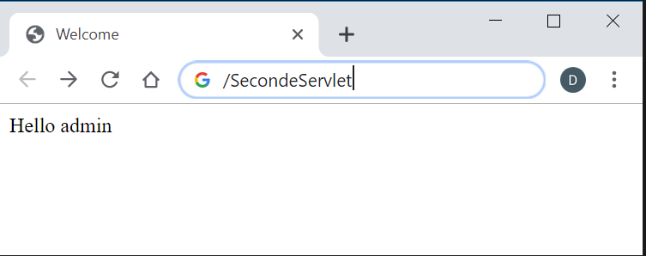
Session Tracking HttpSession
login.html
After clicking Submit:
After clicking Visit:

Slide 31
Session Tracking URL Rewriting
Append a token or identifier to the URL. We can send parameter name/value pairs using the following format:
url?name1=value1&name2=value2&
When the user clicks the hyperlink, the parameter name/value pairs will be passed to the server. We can use getParameter() method to obtain a parameter value.
Advantage of URL Rewriting
It will always work whether cookie is disabled or not (browser independent).
Extra form submission is not required on each pages.
Disadvantage of URL Rewriting
It will work only with links.
It can send Only textual information.

Slide 32
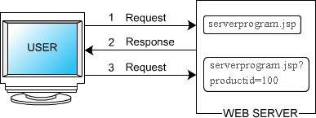
Session Tracking URL Rewriting
The session ID is encoded in the URLs that are created by the JSP pages
<b>Search results for books</b>
<form method="post" action="serverprogram.jsp">
// Provides check box for different products
<input type="checkbox" name="productID" value="100">
CD MP3 Converter Kit For Your CAR<br>
<input type="checkbox“ name="productID" value="101">
Front Loading Car MP3/CD Player With Anti Shock Memory and FM<br>
<input type="checkbox“ name="productID" value="102">
CAR/Home DVD/VCD/MP3 Playerwith anti shock for Indian Roads<br>
// Submits the user input to URL
<input type="submit“ name="Submit" value="Add to Cart"><br>
</form>
URL of server side program

Slide 33
Session Tracking URL Rewriting
// URL for server side program after the user selects a product
// and goes to another page
<form method="post" action="serverprogram.jsp?productID=102">
// Provides check box for different products
<input type="checkbox" name="productID" value="150">
DVD Player with built in Amplifier <br>
<input type="checkbox" name="productID" value="160">
Ultra Slim DVD Player Multi Region 5.1 Digital<br>
// Submits input to the URL
<input type="submit" name="Submit" value="Add to Cart"> <br>
</form>

Slide 34
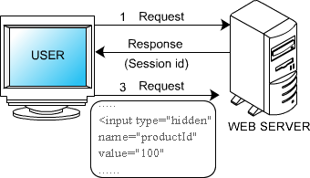
Session Tracking Hidden Form Fields
We store the information in the hidden field and get it from another servlet.
This approach is better if we have to submit form in all the pages and we don't want to depend on the browser.
<input type="hidden" name="uname" value="Vimal Jaiswal">
Advantage of Hidden Form Field
It will always work whether cookie is disabled or not.
Disadvantage of Hidden Form Field:
It is maintained at server side.
Extra form submission is required on each pages.
Only textual information can be used.
When the user visits the next page, the server side program reads all the parameters that a user passes in the previous form

Slide 35
Session Tracking Hidden Form Fields
<b>Search results for books</b>
<form method="post" action="serverprogram.jsp">
// Hidden input field
<input type="hidden" name="productID" value="100">
// Provides check box for user input
<input type="checkbox" name="productID" value="150">
DVD Player with Built in Amplifier <br>
<input type="checkbox" name="productID“ value="160">
Ultra Slim DVD Player Multi Region 5.1 Digital<br>
// Submits user input to the server side program
<input type="submit" name="Submit" value="Add to Cart"><br>
</form>

Slide 36
Summary
Servlet Exception Hadling
ServletConfig and servletcontext
Servlet Session Tracking
Q&A

Slide 37

Thank you
37

